Slide 1
Web Hosting
VPS|Ubuntu 22.04|nginx|domain|Github|CI/CD Pipeline

Slide 2
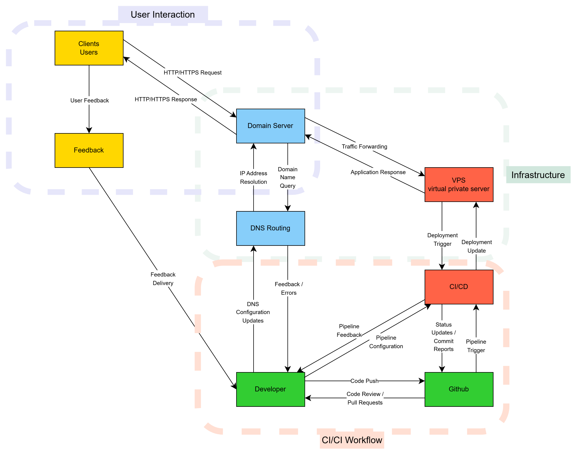

Slide 3
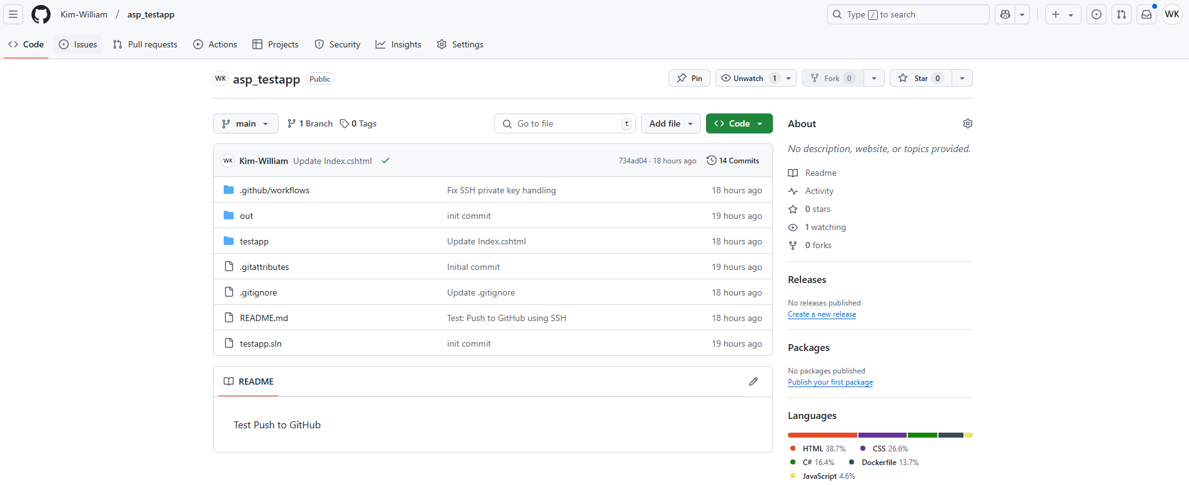
My GitHub repository name is 'asp_testapp', not 'test'.

Slide 4
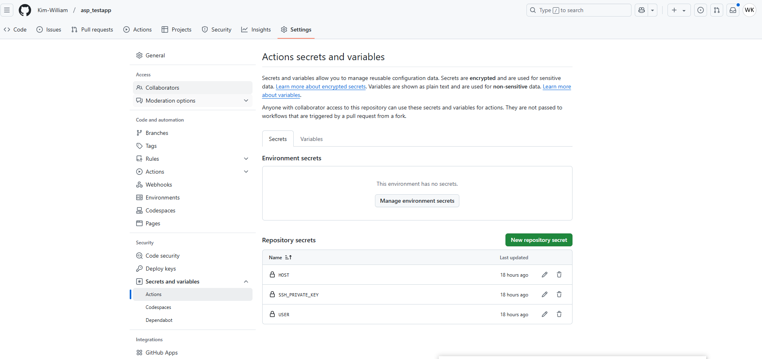
Add 3 Secrets as shown in the picture and enter the values.

Slide 5
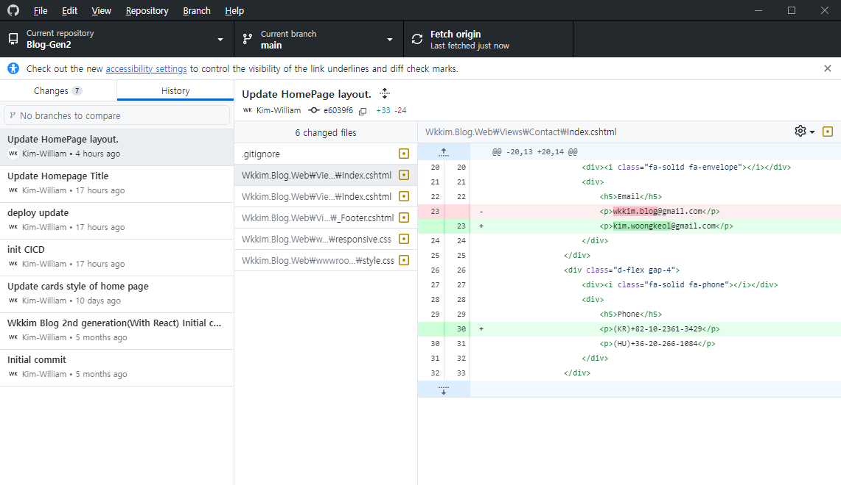
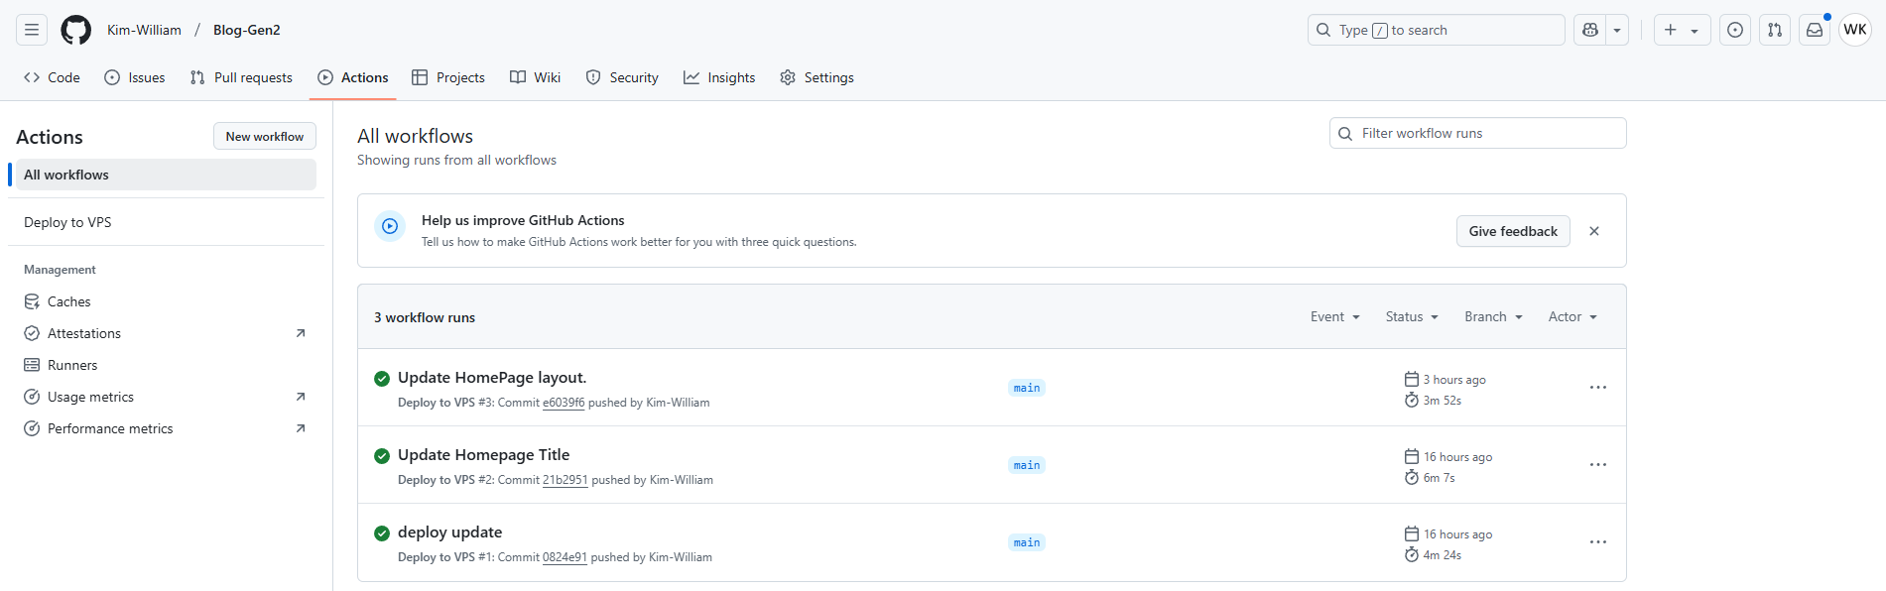

When I modify the code and push it to Github, it is automatically distributed to the server set up in GitHub.
www.woongkeol.blog

